Slide 1
Application materials
Program continuation, tailored and full review

Slide 2
Contents
  Differentiated application process and review process
  Key principles and developing process
  Program Continuation
  Tailored Review
  Material Change
  Transition
  Full Review
  Core documents
  Backup
1
2
3
4
5
6
7
1

Slide 3
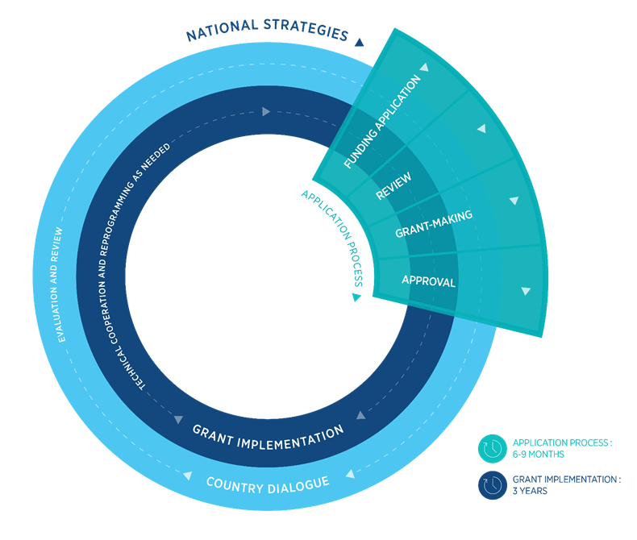
Differentiated application and review process: 3 approaches
Grant Implementation
Program Continuation
TRP validation
Grant-making
Tailored
TRP Tailored Review
GAC + Board
Full Proposal
TRP Full Review
Reprogramming request at any time
Implementation ongoing throughout grant lifecycle
Notes:
Program continuation applicants are validated by the TRP and go straight to grant-making, GAC and Board approval and grant implementation. There is no new funding request needed.
Tailored review and full review funding requests will be reviewed by the Technical Review Panel, similarly to past funding cycles, and then move into grant making and grant implementation.

Slide 4
Contents
  Differentiated application process and review process
  Key principles and developing process
  Program Continuation
  Tailored Review
  Material Change
  Transition
  Full Review
  Core documents
  Backup
1
2
3
4
5
6
7
3

Slide 5
Key principles of the funding request
What is new, different or simplified?
Program Continuation
Tailored and Full
    Enables grants to continue without interruptions when no material change has occurred.
    Streamlining – one document only.
    Responses to each question should be brief and should clearly demonstrate how the current investments are in line with achieving maximum impact.
    To avoid lengthy repetition of information available elsewhere, reference to supporting documents and evidence is strongly encouraged, as appropriate, building on existing national and portfolio information.
    What is different or simplified?
    Only one template to fill for the three diseases and RSSH.
    Some questions removed (on the development of the NSP, minimum standards on PR selection and when tables are self-explanatory).
    Some questions simplified(questions and tables within the narrative and use “yes or no” questions and tables within the narrative).
    Less templates and tools to fill
    Avoids duplication on effort (building on epi information and using core documents beyond the funding request).
    What is new?
    A more robust section on sustainability and co-financing.
    Request the LoHp and key assumptions in some instance.
    What is the same?
    Application package formed by a narrative, core documents, annexes, CCM ER.
    Modular framework is still used (although it has been updated).
    Level of detail of the financial information (key assumptions).
Notes:
In this regard, word limitations per response provide an opportunity for streamlining and refocusing the applicant’s response on key information Submission of a program continuation request (5 pages).

Slide 6
Concept note
(Old)
Material
change
Focused on changes
National Strategy Pilot
Program continuation
Full review
COEs
Transition
Max. # of pages
per component
30
15
8
14
13
7
5
Section
1
Available documentation
(table)
Triggers for reprogramming
& narrative
Available documentation + SAP-based COE specific (table)
Transition Readiness Assessment
(or equivalent)
NSP main read: table with referenced sections
Context
Narrative
Section 2
Funding
request
Disease-specific
& RSSH split
Based on SAP funding request
COE specific
(chronic or acute instability)
Section 3
Tailored & link to work-plan
Section 3.1
Optional:simplified narrative if no changes (Y/N)
Only updated in case of changes (Y/N)
Tailored to transition
Only updated in case of changes (Y/N)
Implementation
arrangements
Section 4
Table+brief narrative
Checklist
Section 3.2
Risk & mitigation measures
Section 4
No narrative (table with recap of risks)
Section 4
Funding landscape
Co-financing & sustainability
Y/N answers with shorter
narrative
Tailored to transition
Y/N answers with shorter
narrative
Section 2
Tailored for COEs
Section 5
PAAR table
PAAR
Section 3
Core Docs
Modular template
Gap tables, Summary Budget, Performance Framework
Simplified
Tailored
Notes:
Comparison of how the different funding request application materials have been simplified or tailored vs. the concept note application from the current cycle.

Slide 7
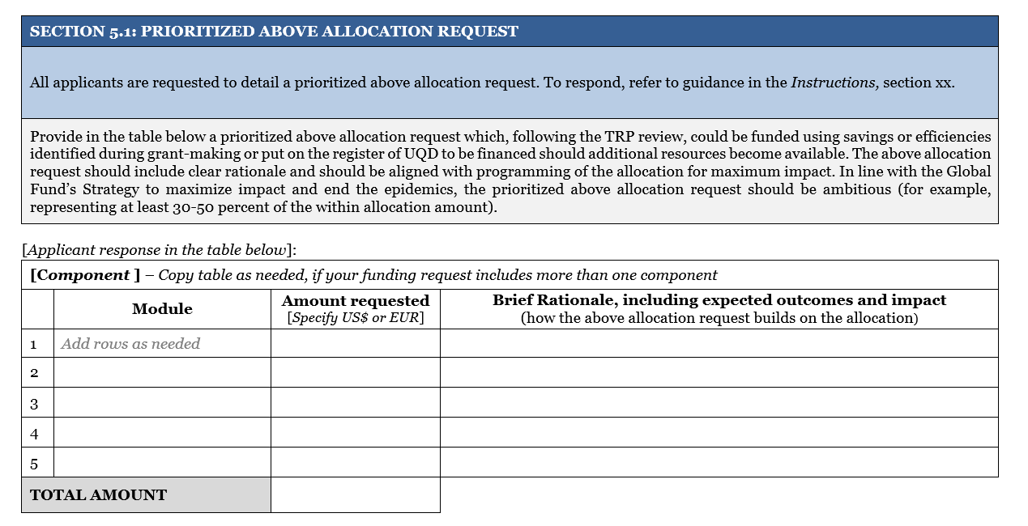
Prioritized above allocation request

Slide 8
CCM Eligibility Requirements
Key principles of the request (2)
1
Transparent and inclusive funding request development process
1 and 2 assessed at funding request submission
Open and transparent Principal Recipient selection process
2
Overseeing program implementation and having an oversight plan
3
Document the representation of affected communities
3 to 6 assessed annually and monitored on going basis
4
Ensure representation of non-governmental members through transparent and
documented processes
5
Develop, publish and follow a policy to manage conflict of interest that applies to all
CCM members, across all CCM functions
6

Slide 9
Contents
  Differentiated application process and review process
  Key principles and developing process
  Program Continuation
  Tailored Review
  Material Change
  Transition
  Full Review
  Core documents
  Backup
1
2
3
4
5
6
7
8

Slide 10
Program Continuation: definition and eligibility
What is Program Continuation?
Enables implementation of the Global Fund grant for additional three years under essentially the same assumptions of the current grant if no material change has occurred in:
the scope and scale of the strategic focus
technical soundness and potential for impact of the investments in a disease program
And there is no immediate material change needed based on an assessment of key triggers.
Who can access funding through Program Continuation?
Focused and Core components with less than 2 years of implementation;
Focused and Core components with demonstrated performance and no material change needed;
High Impact components considered on case-by-case basis.

Slide 11
Is Program Continuation for me?
Disease Program
If no material change
If material change
When?
Later
Now
TRP validation
TRP validation
Program continuation
Program continuation (re-programming during grant implementation)
Tailored/ Full review
Notes:
The Secretariat and Technical Review Panel decide on material change triggers for each application process. The criteria for change assessment is based on the following:
Allocation and funding landscape
Results and performance
Epidemiology contextual considerations
Investing to maximize impact, noting scientific evidence or normative guidance and new technologies
Effectiveness of implementation approaches
Risk mitigation considerations
Progress on TRP, GAC and Board recommendations
Ensuring sustainable health systems, human rights and gender programming
Sustainability, transition and co-financing
If, after Secretariat and applicant assessment, there is no material change, the funding request will go directly to the Technical Review Panel for review and on to grant-making. If there is material change, the application will be recommended for tailored or full review.

Slide 12
What is a material change?
Changes to scope and scale resulting in substantial adjustments in the overall strategic focus, technical soundness and potential for impact of investments in a disease program.
Additional guidance
“OPN on Reprogramming”
It contradicts the TRP’s original or modified review and recommendation on the funding request
  There is a lack of agreement in the normative guidance, significant gaps in evidence to support a reprogramming need, unexplained lack of impact, or difficult trade-offs in decision making which therefore requires an independent technical review of the reprogramming request; OR
  Additional Global Fund financing representing more than a 30% increase or decrease to the approved funding for the implementation period is allocated to an existing disease or RSSH program.
  “Instructions for Program Continuation Request”
Notes:
Non-material is a change that does not significantly shifts scope and scale of the program, is isolated and does nor require re-thinking of the program

Slide 13
How is it assessed?
TRP agreed criteria to asses relevance of strategic focus and technical soundness; and potential for impact in line with GF Strategy.
Allocation and funding landscape
Results and performance (programmatic and financial)
Risk considerations
Progress on TRP/GAC and Board recommendations
STC requirements (e.g. application focus, co-financing)
Epidemiological contextual updates
NSP revisions and updates
Investing to maximize impact towards ending the epidemics (noting choice of interventions, normative guidance, new technologies, etc.)
Effectiveness of implementation approaches
Funding landscape and STC
Ensuring RSSH & HRG in line with Strategy
Secretariat Assessment
Applicant Assessment
TRP validation

Slide 14
Program Continuation Request
Overview
The request is composed by three interrelated parts:
      Program Continuation Request Cover Letter;
      Applicant Self-Assessment;
      Annex 1: Checklist to confirm inclusiveness of key populations in the process of developing the request.
Applicants for PC must submit all three parts jointly;
One program continuation request per disease component - For countries with high TB/HIV co-infection, one joint program continuation request should be submitted (response space doubled).
Notes:
If decide not to go for PC then just a cover letter

Slide 15
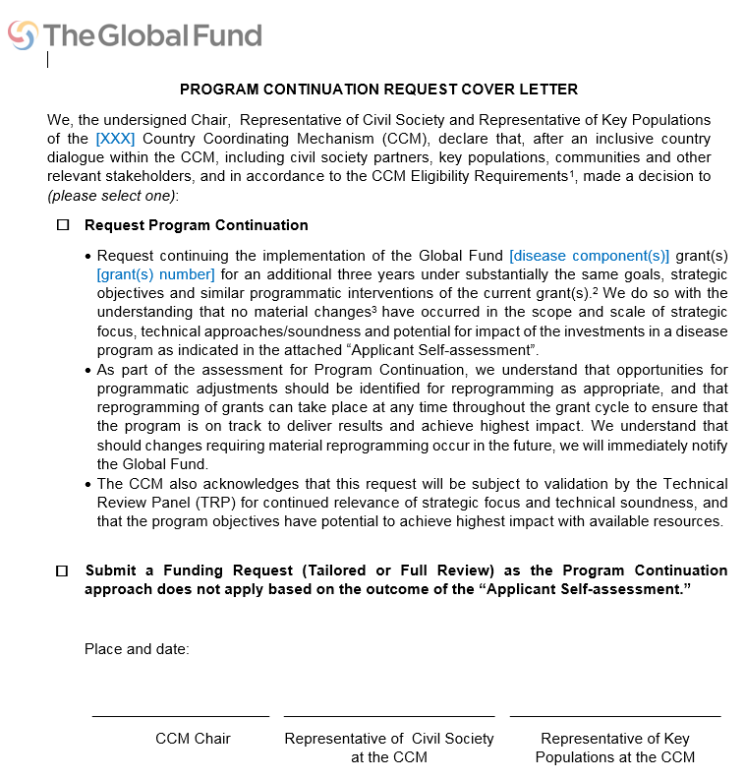
Program Continuation Request
Cover Letter
Communication through which the CCM informs the Global Fund of its choice about the application approach;
Based on the applicant self-assessment, applicants can opt for program continuation or can decide to go through a tailored or full review;
If applicants decides tailored or full review is more suitable, they can only complete the cover letter.

Slide 16


Program Continuation Request
Applicant Self-Assessment
Provides applicant’s rationale for continuation of existing Global Fund-supported grants;
Provides a series of questions to verify whether the program can be implemented under substantially the same goals, strategic objectives and similar programmatic interventions of the current programs;
Evaluates if material changes have occurred or are envisioned;
If yes, when and at which stage they should be addressed.
Notes:
Change per se does not cancel the PC process. Each change has to be assessed by its materiality and then by envisioned planning – if to happen in the future then can be addressed during the grant implementation

Slide 17
Program Continuation Request
Applicant Self-Assessment
Structure
1. Epidemiological contextual updates
2. National and strategies revisions and updates
3. Investing to maximize impact towards ending the epidemics
4. Alignment with 2017-2022 Global Fund Strategy Objective 2 and 3
Objective 2 to Build Resilient and Sustainable Systems for Health
Objective 3 to Promote and Protect Human Rights and Gender Equality
5. Effectiveness of implementation approaches
6. Sustainability, transition, and co-financing
Notes:
Change per se does not cancel the PC process. Each change has to be assessed by its materiality and then by envisioned planning – if to happen in the future then can be addressed during the grant implementation

Slide 18
Program Continuation Request
Applicant Self-Assessment
Special considerations:
Section 3: if impact not achieved because of the short-implementation period of the on-going grant, Challenging Operating Environment or if data is not available – provide additional information
Section 4, Objective 3: the purpose is to stimulate and facilitate discussion, not interfere the process. The details to be discussed and negotiated during grant making.
Section 6: few countries to respond “No”, more detailed response (extended words limits), refer to “Instructions.”
The applicant will need to provide documentation to support the co-financing commitments during grant making.
Notes:
Each section should be answered if change has occurred, if so when it will be addressed, if immediately then other funding approach.

Slide 19

Program Continuation Request Annex 1
Ensures inclusiveness of engagement with key populations with the decisions and preparations of the Program Continuation request;
Places special attention on key populations that are targeted by the program but not represented in the CCM, if relevant;
Special provision for malaria programs.

Slide 20
Next steps
1. Application and review modality is communicated to applicants in their allocation letters.
2. Applicants selected for Program Continuation receive the appropriate documentation for submitting the request.
3. Upon completion of request, applicants submit the package (including Annex 1).
via email to the respective Fund Portfolio Manager or through the Global Fund Partner Portal
There will be two windows to submit Program Continuation Request for TRP validation:
Window 1: 20 March 2017 for grants ending until 30 June 2018
Window 4: 31 January 2018 for grants ending beyond 1 July 2018.

Slide 21
Contents
  Differentiated application process and review process
  Key principles and developing process
  Program Continuation
  Tailored Review
  Material Change
  Transition
  Full Review
  Core documents
  Backup
1
2
3
4
5
6
7
20

Slide 22
Contents
  Differentiated application process and review process
  Key principles and developing process
  Program Continuation
  Tailored Review
  Material Change
  Transition
  Full Review
  Core documents
  Backup
1
2
3
4
5
6
7
21

Slide 23
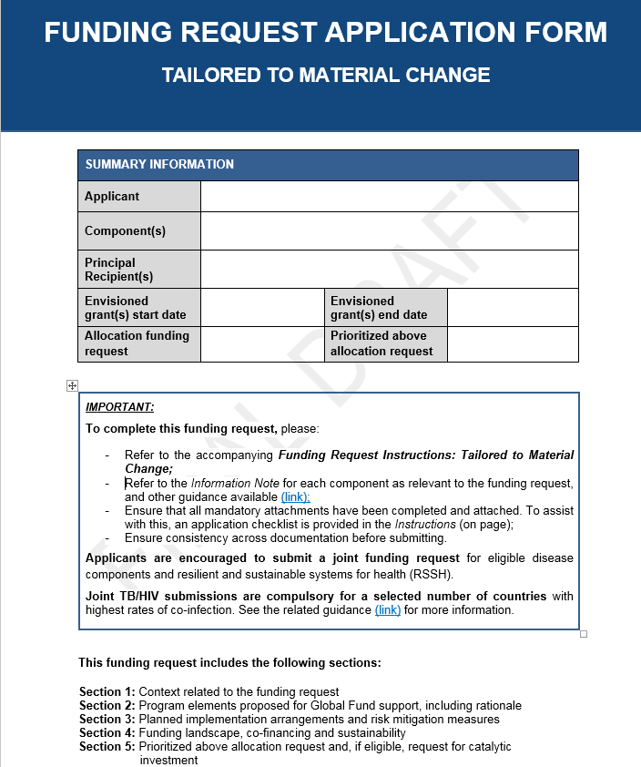
Tailored to material change application form (1/3)
Overview
Based on essentially the base assumptions of the current grant:
      Material change in the scope and scale of the strategic focus, technical soundness and potential for impact.
      Immediate need for material change.
Designed to:
      Re-assess the response against new evidence.
      Re-assess the programmatic gaps and funding landscape.
      Re-prioritize funding needs and revise the response for the highest impact.
      Ensure most appropriate operationalization, risk mitigation and financial sustainability.
      Determine further prioritization in case additional resources become available.
    For more information see: Operational Policy Note on Access to Funding and Grant-making

Slide 24
Tailored to material change application form (2/3)
Questions
Focus on what will change and why:
Explain factors triggering the need for material changes.
Explain context of changes:
      Alignment with existing and latest information sources
      Information on key and vulnerable populations, human rights and gender, as applicable
      Build on lessons learned
    Priorities should remain maximizing impact and effective use of GF resources.
    Outline the changes such as impact on targets, geographic coverage, or the diversity/quality of the service packages, budget.

Slide 25
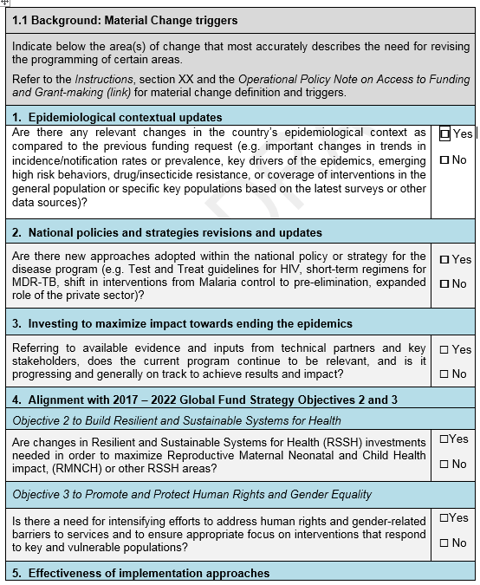
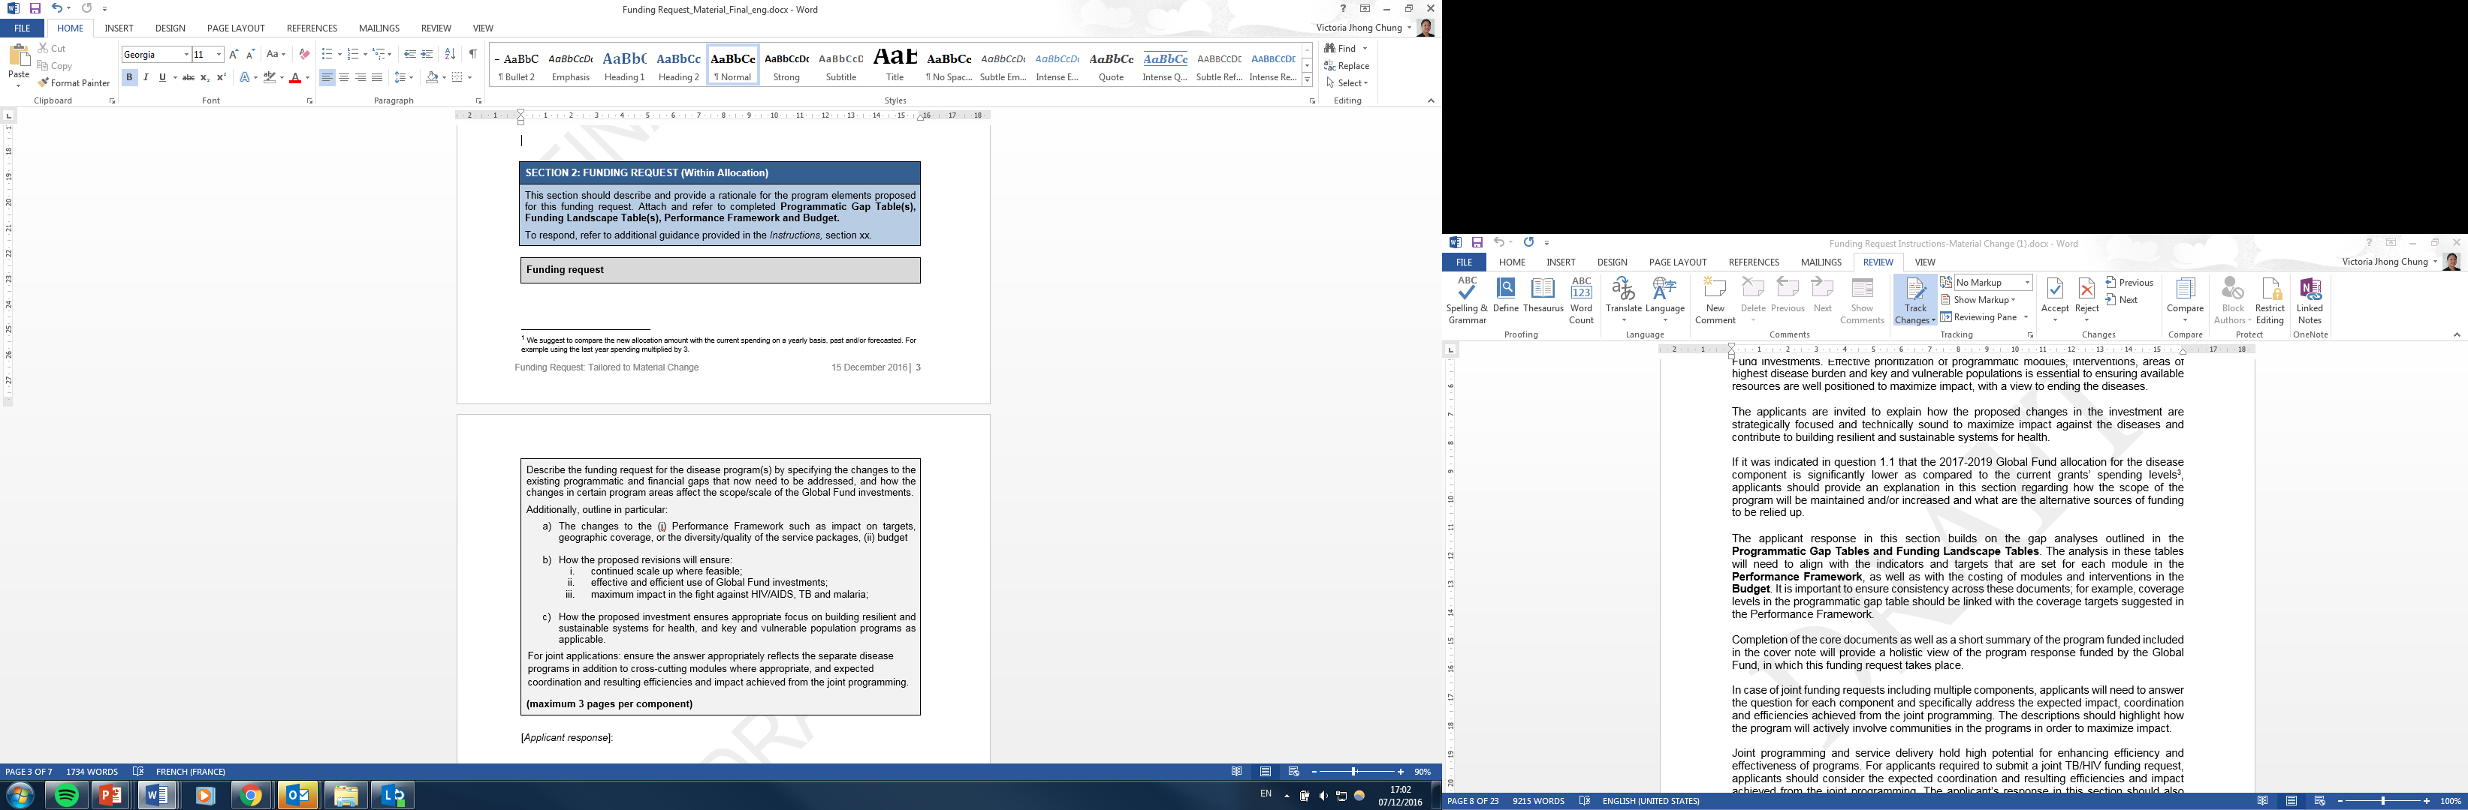
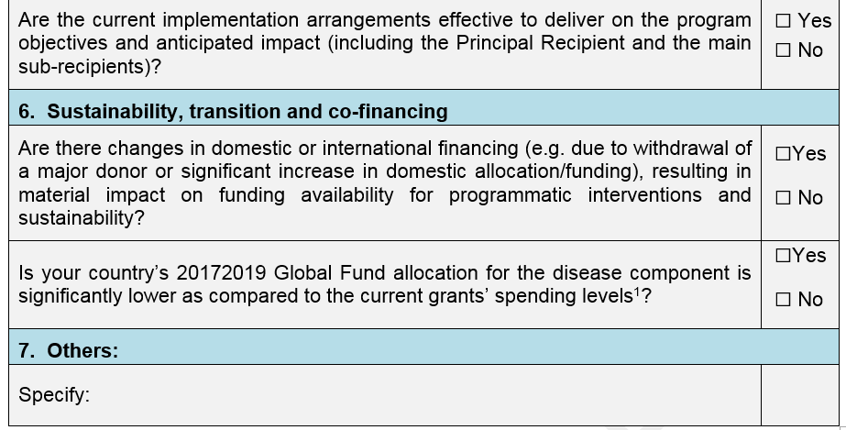
Tailored to material change application form (3/3)
Questions
Section 1: Checklist to assess the material changes that might have occurred in the country. Applicants also describe the major reasons for programmatic changes.
Funding request section:
      Focus on the proposed changes to the existing program.
      Describe the re-prioritization resulting from these changes and proposed for funding, if applicable.
      Provides an explanation on how the scope of the program will be maintained if there was a significant decrease in Global Fund allocation

Slide 26
Contents
  Differentiated application process and review process
  Key principles and developing process
  Program Continuation
  Tailored Review
  Material Change
  Transition
  Full Review
  Core documents
  Backup
1
2
3
4
5
6
7
25

Slide 27
Key principles of the funding request
What is new?
Approach: Disease components receiving their final round of transition funding and those projected to become high income countries. Based on the Sustainability, Transition and Co-financing (STC) policy
Tailored: Application materials completely tailored to transition activities.
Based on: Country-level activities in the Transition Work Plan (required) or National Strategic Plan
Identifies: Gaps and challenges based on Transition Readiness Assessment or equivalent or National Strategic Plan.
Focus: Priority needs and investments that address transition and sustainability bottlenecks, as well as key and vulnerable populations.
Mandatory section on prioritized above allocation request in funding request.
      All applicants are requested to submit an above allocation request which represents at least 30% of the within allocation amount.
Notes:
NSP which may contain a section on transition.

Slide 28

Tailored to transition application form
Overview
Designed to:
        Understand the country context and assess the response to date
        Define the key transition gaps and funding landscape
        Prioritize transition needs and choose best interventions for ensure effective transition
        Ensure appropriate operationalization and risk mitigation
        Determine further prioritization in case additional resources become available

Slide 29

Tailored to transition application form
Section 1
Points out to pertinent epidemiological and programmatic context.
Highlights what the National Strategic Plan (NSP) is, aiming to achieve in response to the epidemiological context, including aspects that relate to sustainability and transition.
Provides a description of the key transition gaps/challenges.
Inclusivity and multi-stakeholder engagement
Past implementation and lessons-learned from Global Fund grants and other donors
Notes:
To avoid lengthy repetition of information available elsewhere, reference to supporting documents and evidence is strongly encouraged, as appropriate, building on existing national and portfolio information.

Slide 30

Tailored to transition application form
Section 2
Applicant’s request within the allocation amount and how the investment addresses priority transition challenges and maintains resilient health systems and sustainable disease responses.
Describes how interventions, for which funding is requested, will ensure effective transition from Global Fund financing, the sustainability of the national program, and the gains achieved with the support of the Global Fund at the end of the grant period.

Slide 31


Tailored to transition application form
Section 3
It requests information on the proposed implementation arrangements for this funding request and identified risks and mitigating measures.
Implementation arrangement summary
      Applicant should explain how the key PR functions will be incorporated into national TORs and structures by the end of the grant.
Key implementation risks
      Describe the key risks identified through the Transition Readiness Assessment or equivalent analysis and as part of the Country Dialogue process.
      Include external risks that may have negative or unintended consequences on program implementation and performance.

Slide 32

Tailored to transition application form
Section 4
Provides an outline of the key review objectives for applicants to assess:
        Trends and actions for increasing government expenditure on health to meet universal health coverage goals and objectives.
        Realization of co-financing commitments of the previous allocation cycle.
        Funding landscape.
        Domestic commitments in the next allocation cycle meet the minimum requirement to access the co-financing incentive.
        Longer term sustainability.
Funding Landscape and Co-financing
      Applicants need to include an explanation and/ or justification linked to their assessment of the funding landscape and co-financing.
Transition and Sustainability
      Applicants should evaluate :
        the overall costs of their national strategy, availability of funds and the funding gap for major program areas.
        Key sustainability and transition challenges of the program(s) for which funding is requested, including key actions related to health financing, RSSH, and the legal environment, as applicable.

Slide 33
Mandatory attachments
What are they?
Transition Work-Plan
Funding
Landscape
Table
Budget
WPTM section
of
PF
Programmatic
Gap Tables
(as applicable)
National
Strategic
Plan
Implementation
Arrangements
Map
List of
Abbreviation
and Annexes
CCM
Endorsement
of funding
request
List of health
products
(if applicable)
CCM Eligibility
Requirements
      Transition Work-Plan:
        Applicants must submit a transition work-plan, which will be the basis for the funding request.
      Funding Landscape:
        Applicants need to include an explanation and/ or justification linked to their assessment of funding landscape and co-financing.
      Budget:
        At the funding request stage only a summary-level budget is required, which includes information by module, intervention, cost grouping and implementer.
      Work Plan Tracking Measures (WPTM) section of Performance Framework:
        If there are no service provisions, then the applicant should go straight to the Performance Framework template and only complete the Work Plan Tracking Measures (WPTM) section.
      Programmatic Gap Table:
        Not required for Transition Funding requests. However, if the funding request includes service provision activities or recurrent costs associated to these, then applicant is required to complete the programmatic gap table.

Slide 34
Transition Work-Plan
For countries approaching transition
Should describe country’s transition-related priority programmatic and financial gaps.
It would ideally be derived from program’s transition or sustainability and transition readiness assessment (or equivalent analysis).
It should be aligned with the NSP.
It needs to provide:
      Description and budget for carrying out activities over the period of the transition grant.
      Roadmap for implementation of activities beyond grant end date.
      For activities that will continue beyond grant end date, a phased financing plan towards full government uptake by the end of the final grant.
      Description and budget of any activities essential for enabling a successful transition that are not financed in the current grant.
Practical
Measurable
Costed
Detailed

Slide 35
Contents
  Differentiated application process and review process
  Key principles and developing process
  Program Continuation
  Tailored Review
  Material Change
  Transition
  Full Review
  Core documents
  Backup
1
2
3
4
5
6
7
34

Slide 36
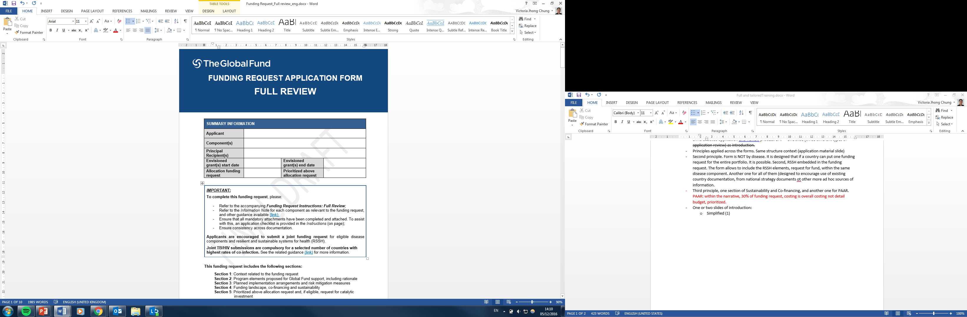
Full Review application form
Overview
A comprehensive review form.
Designed to
      Overview of the disease and health system context.
      Understand the programmatic gaps and funding landscape.
      Prioritize funding needs and choose best response for highest impact.
      Ensure appropriate operationalization, risk mitigation and financial sustainability.
      Determined further prioritization in case additional resources become available.

Slide 37
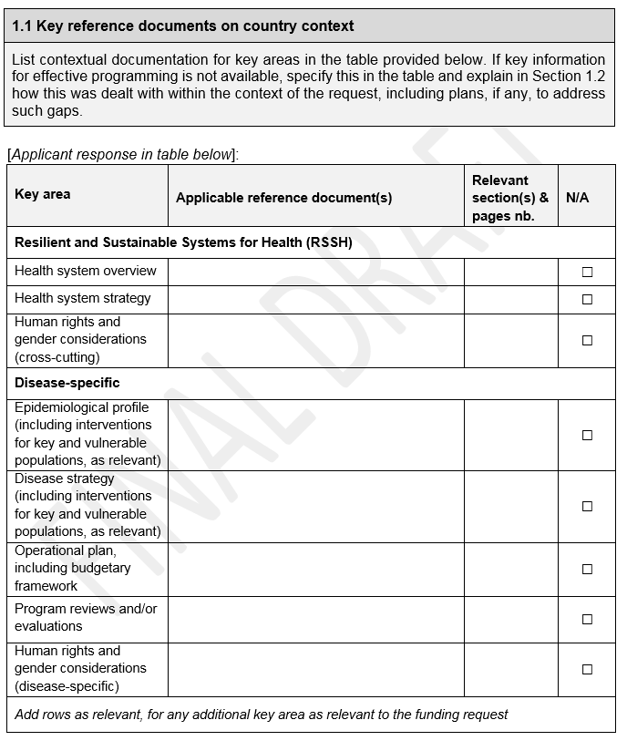
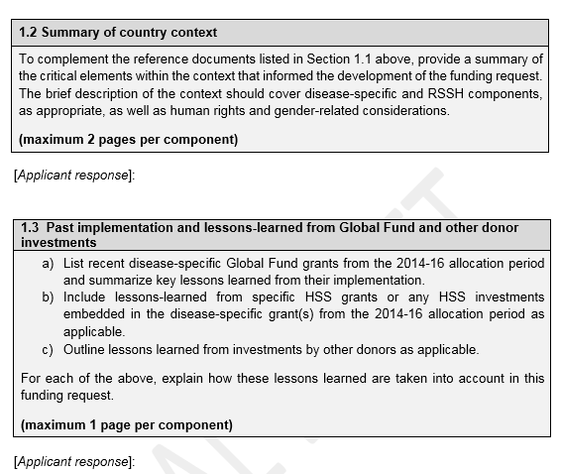
Full Review application form
Questions
Request for concise but relevant information using tables and yes/no questions.
Prompt applicants to build on information already available.
Requests key sources of information and a brief analysis on main considerations.
Builds on lessons-learnt and past implementations.

Slide 38
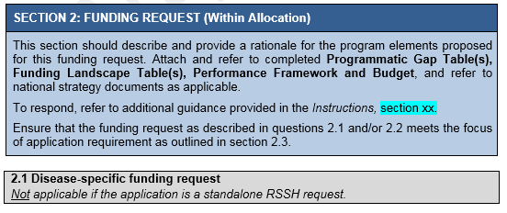
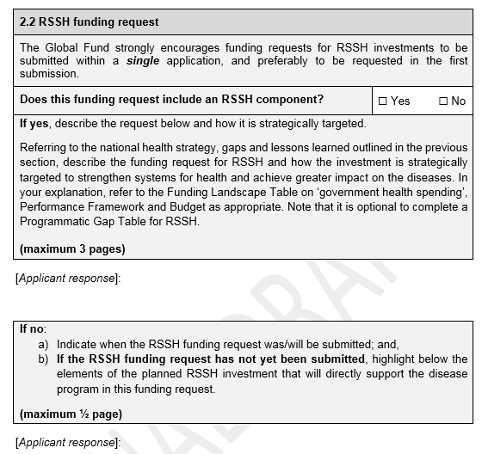

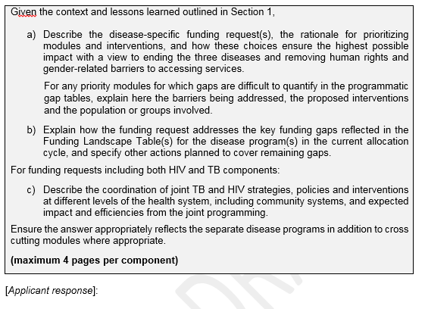
Full Review application form
Questions
Funding request section:
      Details applicant’s request within the allocation amount.
      Builds on the gap analysis outlined in the Programmatic Gap tables and Funding Landscape tables.
      Analysis should be aligned to the Performance Framework and budget.
      Critical modules for the program should be included in the funding request.
      RSSH embedded in the application.
      LMI and UMI must demonstrate the selected modules meet the focus of application requirement.

Slide 39
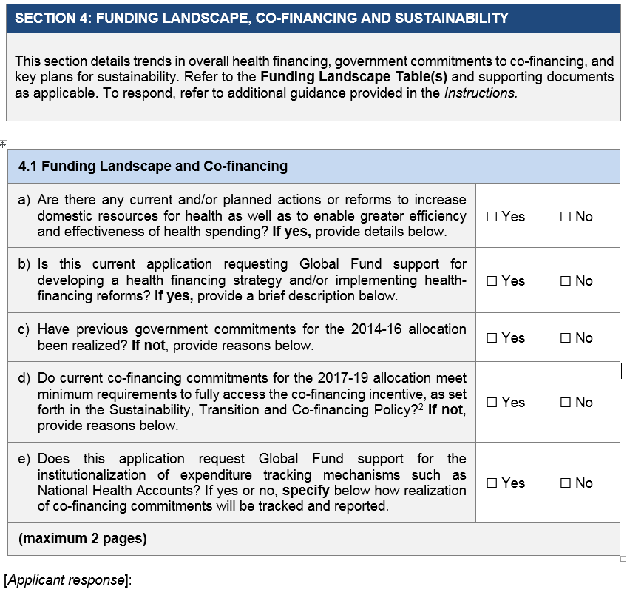
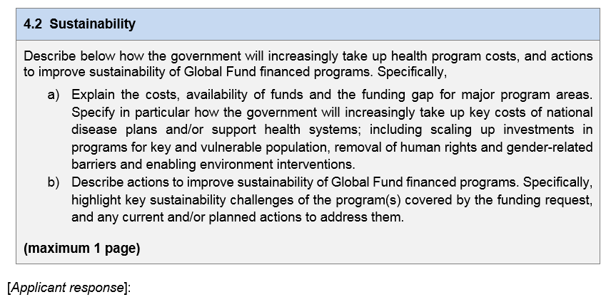
Full Review application form
Questions
Funding Landscape, Co-financing and Sustainability section assesses:
      Trends and actions for increasing government expenditure on health to meet universal health coverage goals.
      Realization of co-financing commitments of previous allocation cycle.
      Funding landscape.
      Domestic commitments in the next allocation cycle meet the minimum requirement to access co-financing incentive.
      Long term sustainability.
    No more minimum threshold requirements for co-financing
    Co-financing incentive of not less than 15% of the Global Fund allocation for each eligible component

Slide 40
Contents
  Differentiated application process and review process
  Key principles and developing process
  Program Continuation
  Tailored Review
  Material Change
  Transition
  Full Review
  Core documents
  Backup
1
2
3
4
5
6
7
39

Slide 41
Core documents
What are they? – what is different?
List of
Health
Products
Funding
Landscape
Tables
Performance
Framework
Summary
Budget
Programmatic
Gap Tables
With
Health Products
Assumptions/
Quantifications
      Modular template no longer required. Instead, use of PF and budget tools.
      Level of detail on PF and Budget will vary: Application (strategic) vs Grant (detailed)
      List of Health Products (LoHP) needed with assumptions /quantifications information for key health products will vary at the application stage according to differentiation
      Core documents can be used beyond application stage:
        PF and budget will be negotiated. PGT can be updated in case of significant change.
        The LoHP is finalized or generated at grant-making based on the negotiated proportion of national health products needs forecast that is funded by GF

Slide 42
Core documents | Application | Grant-making | Implementation and Revision
Performance Framework | Strategic information: impact, outcome, modules, annual or bi-annual targets Main assumptions | Negotiation of details: Indicators, targets, reporting, etc. | Used for monitoring, reporting, disbursing Updated as needed in case of material and non-material revisions
Budget | Strategic information: Cost per module, interventions, implementer and year Main assumptions | Negotiation of details: cost assumptions, activities, etc. | Used for monitoring, reporting, disbursing Revised at the time of material revisions
List of Health Products with assumptions /quantifications information | LoHP required for HI countries and key health products Assumption/quantif. info. needed in free format | Negotiation of details: List of all HP to be procured with grant funds Values of the LoHP is imported/reconciled in the budget | Serves as the basis for grant supply plan for health products Used for monitoring procurement compliance with approved products and quantities LoHP updated annually to accommodate changes Basis for contracting and allocation of suppliers for PPM
Programmatic gap tables and Funding landscape tables | Submitted for Full and Tailored reviews Starting point for Prioritized Above Allocation Request and setting targets Key documentation for reporting compliance with co-financing requirements | Update in case of significant change | Used for understanding gaps in programmatic coverage Key input to the Results Framework for reporting Global Fund Results Updated in case of changes (esp. for HI and some core countries) Can be used for deciding material revisions Basis for monitoring domestic financing commitments, measuring KPIs and strategy implementation plan indicators on domestic financing

Slide 43
D4I and Core Documents
 | Performance Framework | Budget | List of Health Products | Programmatic Gap Tables | Funding Landscape Tables
Focus | Recommended: minimum number of mandatory indicators (1-5 impact/outcome and 3-5 coverage indicators) | Up to cost grouping level | Not required. Assumptions and quantifications (free format) if budget for HP exceeds 50% and/or at CT discretion. | Aligned with performance framework for coverage indicators | Only financial data at the program level (except for Upper-Middle Income Countries)
Core | Key programmatic indicator selected from the core list based on interventions/ activities supported by the grant | Greater level of detail | Optional. Can be requested if budget for HP exceeds 50% and/or at CT discretion. Assumptions and quantifications (free format) is required | Based on prioritized modules and coverage indicators | Only financial data at the program level (except for Upper-Middle Income Countries)
High Impact |  | Greater level of detail | Required. LoHP required with detailed info for key health products. Assumptions and quantifications in free format is required |  | Financial data at the program and intervention level

Slide 44
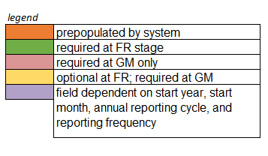
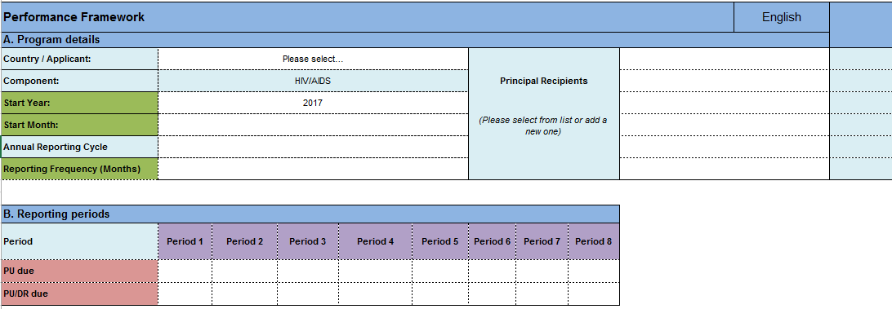
Performance Framework (2/4)
Overall approach not changed except that now it is used at the funding request stage.
Program details
Reporting periods
Not final design
(in revision by AIM)

Slide 45
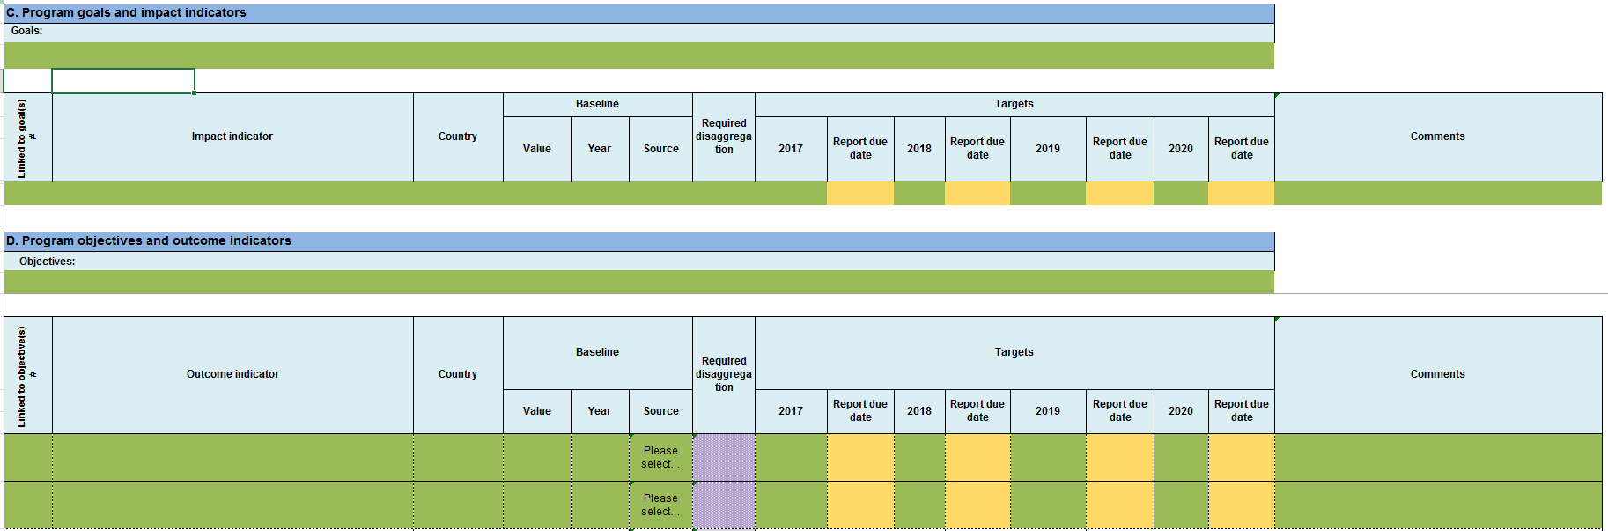
Performance Framework (3/4)
C. Program goals and impact indicators
D. Program objectives and outcome indicators
Not final design
(in revision by AIM)

Slide 46
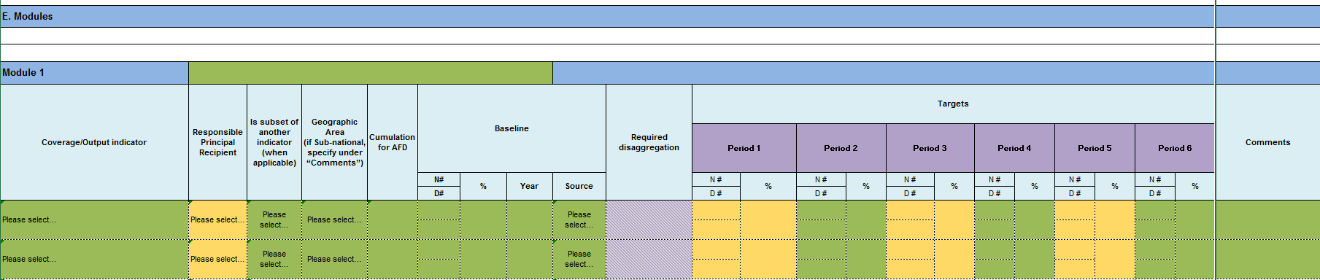
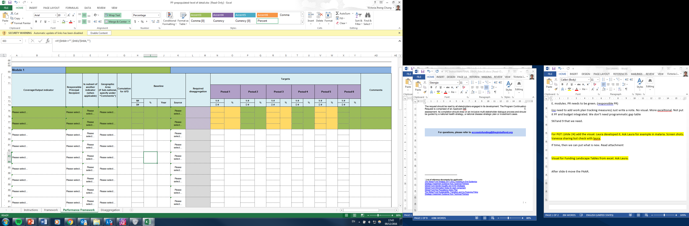
Performance Framework (4/4)
E. Modules
Not final design
(in revision by AIM)

Slide 47
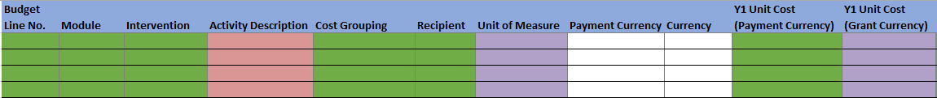
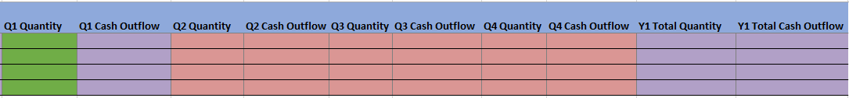
Budget
Not final design
(in revision by AIM)
One budget per request.
No quarterly breakdown at time of application (Q1 reflects Y1)
Summary budgets for intervention and cost grouping are calculated automatically by completion of detailed budget.
Key assumptions needed but detailed cost assumptions are not required at the funding request stage
  but the option to provide it will be given (and is recommended).
Repeated for Y2 & Y3

Slide 48
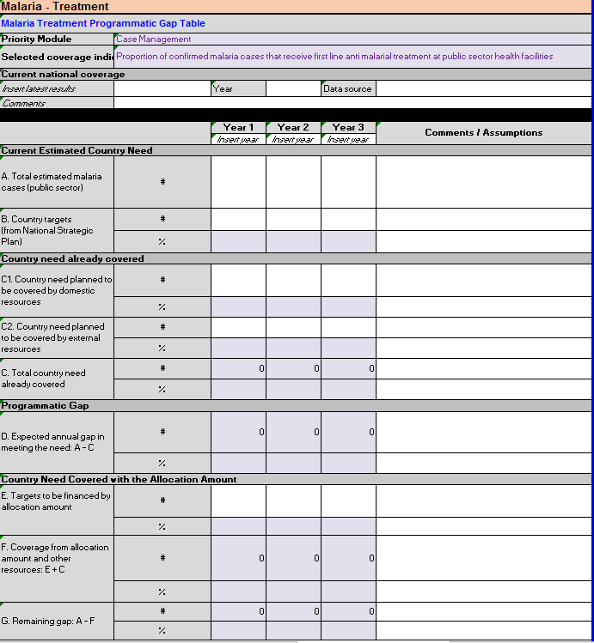
Programmatic Gap Tables
What’s new (and what is not)
No changes to structure, but changes mainly introduced to:
      Incorporate lessons-learned from past cycle
      Align with partners and global strategy and guidance
      Improved functionalities
Main changes are as follows:
      Implementation period is now 3 years
      Breakdown of need already covered by domestic vs. external resources
      Disease specific changes: HIV, TB, Malaria

Slide 49
Funding Landscape Tables (1/2)
What’s new (and what is not)
Name has changed from Financial Gap Analysis and Counterpart Financing Table
Changes mainly introduced to align to the new Sustainability, Transition and Co-Financing Policy – put in note
Main changes concern:
      Counterpart financing section calculating share of government contribution has been removed
      Introduction of gap detail per disease – High Impact and Upper-Middle Income Countries only

Slide 50
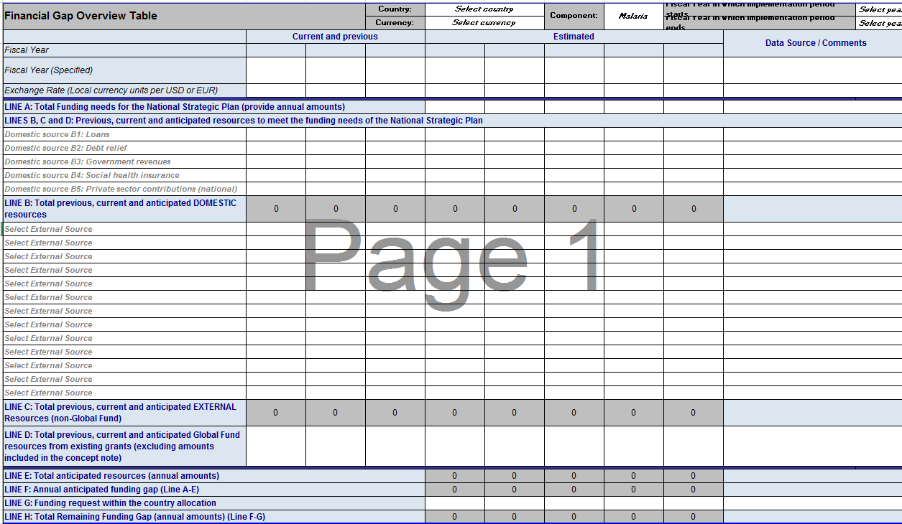
Funding Landscape Tables (2/2)
funding request)

Slide 51
Attachments
Funding request cover note
Funding request application form
Programmatic Gap Tables
Funding Landscape Table(s)
Performance Framework
Budget
List of Health Products (if applicable)
National Strategies (Health Sector and Disease specific)
Implementation Arrangements Map (optional)
List of abbreviations and annexes
CCM Eligibility Requirements documentation
CCM Endorsement of Funding request
All supporting documentation referenced in the funding request

Slide 52
CCM eligibility type of review: Light for program continuation
PROGRAM CONTINUATION
Program Continuation Request Cover Letter signed by CCM Chair, Representative of Civil Society and Representative of Key Populations acknowledging the compliance of requirements 1 and 2. The Secretariat reserve the right to request meeting minutes and request to address the issues identified.
To confirm inclusiveness of engagement with key and vulnerable population in the process of developing the Program Continuation Request: checklist in Annex 1*.
*for malaria programs it is to ensure that civil society and community organizations engaged in responding to malaria have been informed and consulted
Notes:
***Meeting minutes will need to reflect outcomes of discussions with broader constituencies, based on the guiding questions/principles given to CCM representatives

Slide 53
CCM eligibility requirements for tailored and full review
TAILORED and FULL
REVIEW
Criteria 1: light or standard screening
Criteria 2: light or standard screening
Requirement 1 - inclusive funding request development process
Light review:
      CCM eligibility narrative
      Statement of compliance with CCM Eligibility Requirement 1
Standard review:
      CCM eligibility narrative
      Key supporting documents
Requirement 2 – transparent and documented PR selection process
Light review if re-selection of PR:
      CCM eligibility narrative
      Statement of compliance with CCM Eligibility Requirement 2
Standard review if new PR or poor performing PR is selected:
      CCM eligibility narrative
      Key supporting documents
Notes:
***Meeting minutes will need to reflect outcomes of discussions with broader constituencies, based on the guiding questions/principles given to CCM representatives

